Slide 1
Evaluation metrics for classification
https://remykarem.github.io/blog/evaluation-metrics.html

Slide 2
Outline
Accuracy
Binary classification
Multiclass classification
Multilabel binary classification
Precision
Binary classification
Multiclass classification
Multilabel binary classification
Recall
Binary classification
Multiclass classification
Multilabel binary classification
f1
Binary classification
Multiclass classification
Multilabel binary classification
AUC
Single-label binary classification
Multilabel binary classification
Confusion matrix

Slide 3
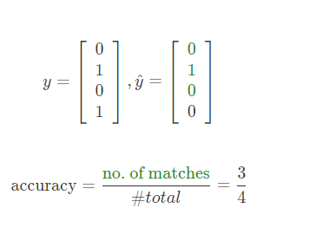
Accuracy
Binary classification
from sklearn.metrics import accuracy_score y_true = [0, 1, 0, 1]
y_pred = [0, 1, 0, 0]
accuracy_score(y_true, y_pred)

Slide 4
Multiclass Vs. Multilabel
Multiclass classification is a classification problem where each data sample can belong to one and only one class. For example, a multiclass classification problem might be to classify images of animals into different categories, such as cat, dog, bird, or fish.
Multilabel classification is a classification problem where each data sample can belong to one or more classes. For example, a multilabel classification problem might be to classify a news article into different categories, such as sports, business, and entertainment.

Slide 5
Multiclass vs Multilabel
Metric | Multiclass classification | Multilabel classification
Number of labels per data sample | One | Zero or more
Examples | Classifying images of animals into different categories | Classifying a news article into different categories

Slide 6
Example.. Multiclass vs MultiLabel
Multiclass classification:
Classifying images of animals into different categories
Classifying emails as spam or ham
Classifying product reviews as positive or negative
Multilabel classification:
Classifying news articles into different categories
Classifying images of objects into different categories
Classifying biomedical text into different categories

Slide 7
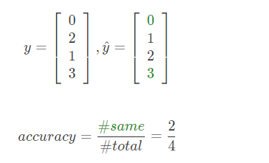
Accuracy
Multiclass classification
from sklearn.metrics import accuracy_score
y_true = [0, 2, 1, 3]
y_pred = [0, 1, 2, 3]
accuracy_score(y_true, y_pred)

Slide 8
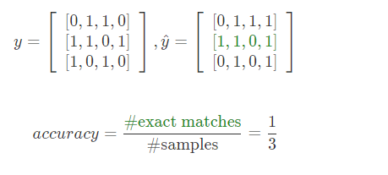
Accuracy
Multilabel binary classification
import numpy as np from sklearn.metrics import accuracy_score y_true = np.array([[0,1,1,0], [1,1,0,1], [1,0,1,0]])
y_pred = np.array([[0,1,1,1], [1,1,0,1], [0,1,0,1]]) accuracy_score(y_true, y_pred)

Slide 9
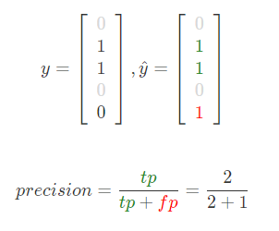
Precision- Ability of classifier to label positives correctly
Binary classification
from sklearn.metrics import precision_score
y_true = [0, 1, 1, 0, 0]
y_pred = [0, 1, 1, 0, 1]
precision_score(y_true, y_pred)

Slide 10
Micro vs Macro
Micro and macro accuracy are two different ways of calculating the accuracy of a machine learning model. Both methods calculate the percentage of correct predictions, but they differ in how they weight the predictions from different classes.
Micro accuracy weights all predictions equally, regardless of the class they belong to. This means that micro accuracy can be biased towards the majority class, especially if the dataset is imbalanced.
Macro accuracy weights all classes equally, regardless of the number of samples in each class. This means that macro accuracy is less susceptible to bias than micro accuracy, but it may not be as sensitive to changes in the performance of the model on individual classes.

Slide 11
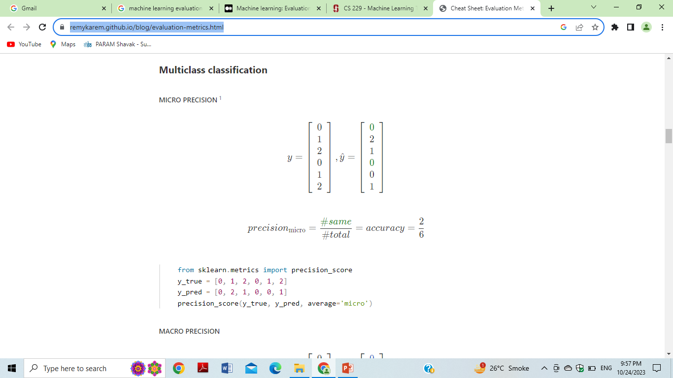
MICRO PRECISION
Multiclass classification
from sklearn.metrics import precision_score
y_true = [0, 1, 2, 0, 1, 2]
y_pred = [0, 2, 1, 0, 0, 1]
precision_score(y_true, y_pred, average='micro')

Slide 12
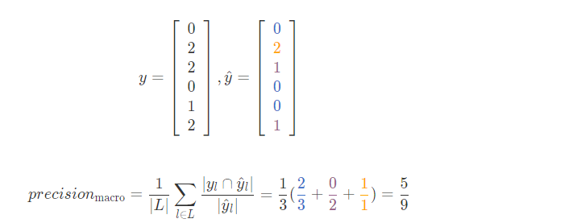
MACRO PRECISION
from sklearn.metrics import precision_score
y_true = [0, 2, 2, 0, 1, 2]
y_pred = [0, 2, 1, 0, 0, 1]
precision_score(y_true, y_pred, average='macro')

Slide 13
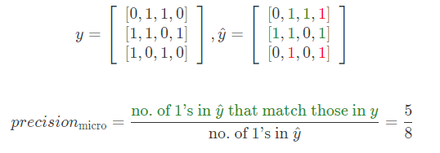
Multilabel binary classification
from sklearn.metrics import precision_score
y_true = np.array([[0,1,1,0], [1,1,0,1], [1,0,1,0]])
y_pred = np.array([[0,1,1,1], [1,1,0,1], [0,1,0,1]]) precision_score(y_true, y_pred, average='micro')

Slide 14
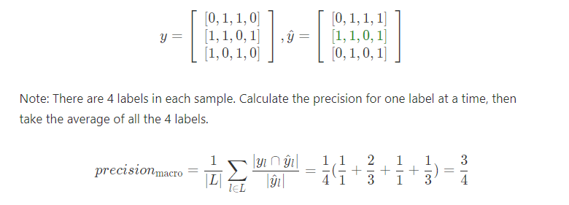
MACRO PRECISION
from sklearn.metrics import precision_score
y_true = np.array([[0,1,1,0], [1,1,0,1], [1,0,1,0]])
y_pred = np.array([[0,1,1,1], [1,1,0,1], [0,1,0,1]]) precision_score(y_true, y_pred, average='macro')

Slide 15
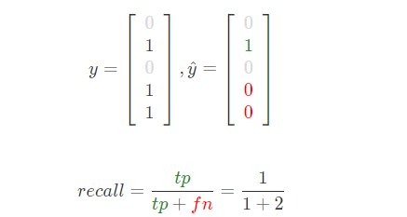
Recall - Ability of classifier to recover the positives
Binary classification
from sklearn.metrics import recall_score
y_true = [0, 1, 0, 1, 1]
y_pred = [0, 1, 0, 0, 0]
recall_score(y_true, y_pred)

Slide 16
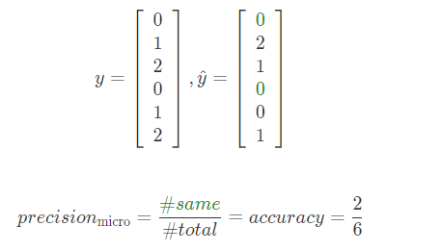
Multiclass classification (micro recall)
from sklearn.metrics import recall_score
y_true = [0, 1, 2, 0, 1, 2]
y_pred = [0, 2, 1, 0, 0, 1]
recall_score(y_true, y_pred, average='micro')

Slide 17
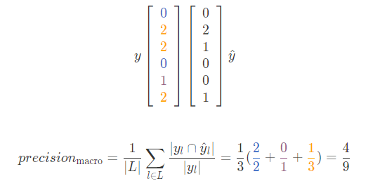
MACRO RECALL
from sklearn.metrics import recall_score
y_true = [0, 2, 2, 0, 1, 2]
y_pred = [0, 2, 1, 0, 0, 1]
recall_score(y_true, y_pred, average='macro')

Slide 18
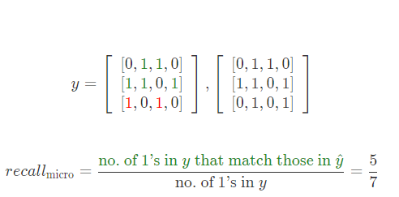
Multilabel binary classification
MICRO RECALL
from sklearn.metrics import recall_score
y_true = np.array([[0,1,1,0], [1,1,0,1], [1,0,1,0]])
y_pred = np.array([[0,1,1,1], [1,1,0,1], [0,1,0,1]])
recall_score(y_true, y_pred, average='micro')

Slide 19
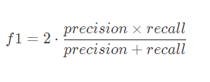
F1
Binary classification
from sklearn.metrics import f1_score
y_true = [0, 1, 0, 1, 1]
y_pred = [0, 1, 0, 0, 0]
f1_score(y_true, y_pred)

Slide 20
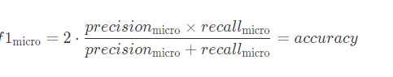
Multiclass classification – F1 micro
from sklearn.metrics import f1_score
y_true = [0, 2, 2, 0, 1, 2]
y_pred = [0, 2, 1, 0, 0, 1]
f1_score(y_true, y_pred, average='micro')

Slide 21
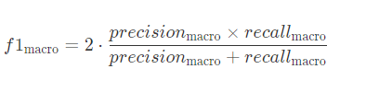
Multiclass classification MACRO F1
from sklearn.metrics import f1_score
y_true = [0, 2, 2, 0, 1, 2]
y_pred = [0, 2, 1, 0, 0, 1]
f1_score(y_true, y_pred, average='macro')

Slide 22
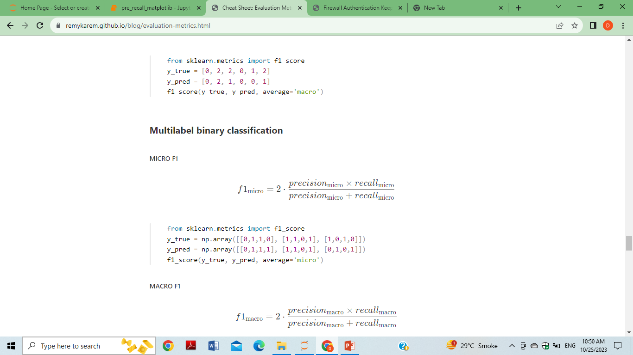
Multilabel binary classification MICRO F1
from sklearn.metrics import f1_score
y_true = np.array([[0,1,1,0], [1,1,0,1], [1,0,1,0]])
y_pred = np.array([[0,1,1,1], [1,1,0,1], [0,1,0,1]])
f1_score(y_true, y_pred, average='micro')

Slide 23
MACRO F1
from sklearn.metrics import f1_score
y_true = np.array([[0,1,1,0], [1,1,0,1], [1,0,1,0]])
y_pred = np.array([[0,1,1,1], [1,1,0,1], [0,1,0,1]])
f1_score(y_true, y_pred, average='macro')

Slide 24
AUC / AUROC (Area Under Curve / Area Under ROC
AUC curve and ROC curve are two important metrics used to evaluate the performance of binary classification models.
ROC curve (Receiver Operating Characteristic curve) is a graph that plots the true positive rate (TPR) against the false positive rate (FPR) at different classification thresholds.
True positive rate (TPR) is the proportion of positive cases that are correctly predicted as positive.
False positive rate (FPR) is the proportion of negative cases that are incorrectly predicted as positive

Slide 25
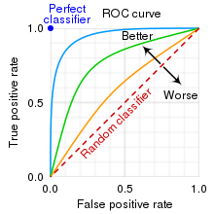

Slide 26
AUC / AUROC (Area Under Curve / Area Under ROC
ROC is plotted on a graph of TPR over FPR, and the area below this graph is called area under curve (AUC). AUC represents the probability that a random positive example is positioned to the right of a random negative example.

Slide 27
ROC curve.
The TPR and FPR can be calculated as follows:
TPR = TP / (TP + FN)
FPR = FP / (FP + TN)
To create an ROC curve, we would plot the TPR against the FPR at different classification thresholds.
For example, we could start with a high classification threshold, where only the most likely cases of disease are predicted as positive. This would result in a low TPR and FPR.
We could then gradually lower the classification threshold, which would increase the TPR but also the FPR.

Slide 28
Good Model
The ROC curve would show how the TPR and FPR change as we adjust the classification threshold.
A good model would have an ROC curve that is close to the upper left corner of the graph, indicating high TPR and low FPR.

Slide 29
AUC
The AUC (Area Under the Curve) is a single metric that summarizes the ROC curve. It is calculated by integrating the ROC curve from (0,0) to (1,1).
AUC ranges from 0 to 1.
A perfect classifier would have an AUC of 1.0, while a random classifier would have an AUC of 0.5.

